Slide 1
Ammunicorn
A 2D Run-and-Gun Action Game

Slide 2

CONCEPT
Ammunicorn is a 2D side-scrolling action game in which a unicorn uses rainbow-based weaponry to free her woodland friends from vicious monsters.
Graham, Clay. The Badass Unicorn. 2014. ArtCorgi. Web. 28 January 2017.

Slide 3
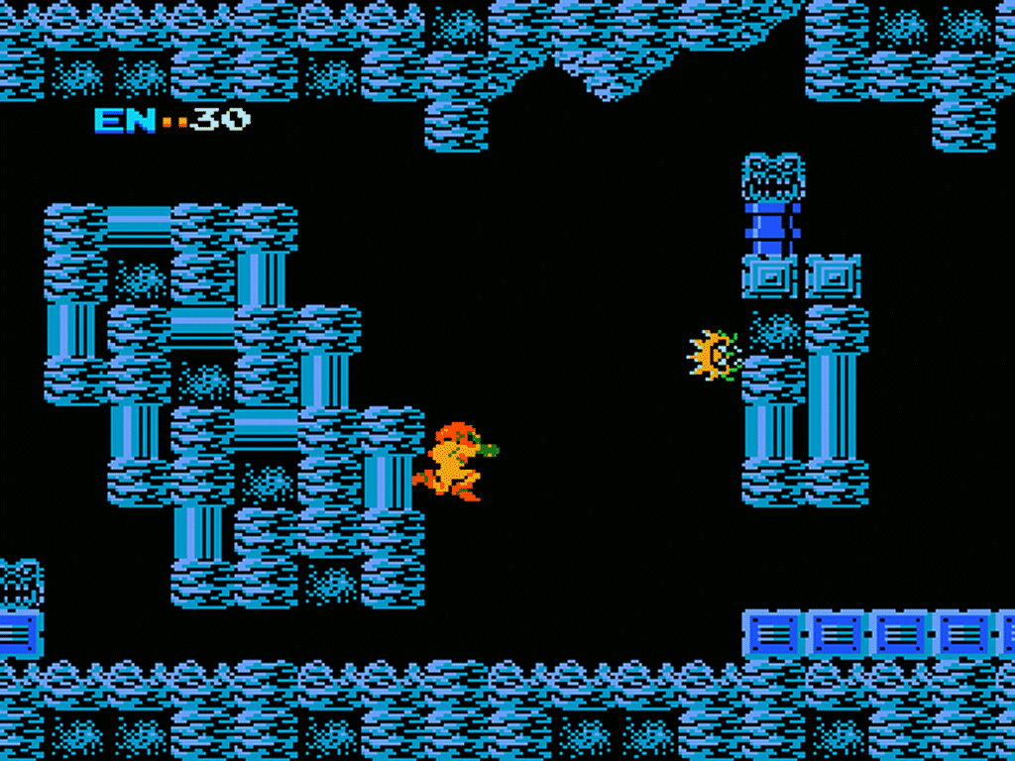
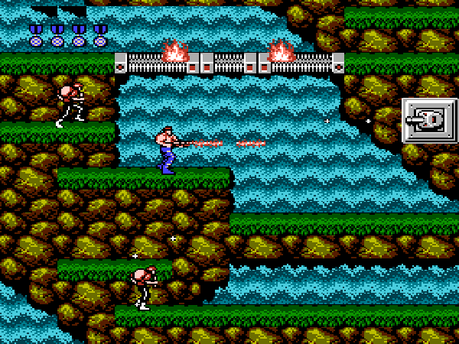
INSPIRATION
Metroid. Nintendo. 1986. Video Game.
Contra. Konami. 1987. Video Game.

Slide 4
PROJECT SCOPE
Running, jumping, shooting player character
Levels with ground, platforms, and pits
Start with one weapon, add variety later
Start with one enemy basic AI, add variety later
Collision detection
Heads-up display
Sound effects and background music

Slide 5
Potential Libraries
Minim Library
Background music
Point sound
AI for 2D Games Library
Creating AI profiles for the enemies
Includes a Vector2D class that uses the double data type instead of float.
Hermes Library
Useful tutorials and possible resource for level-building
https://github.com/rdlester/hermes/wiki/Tutorial-Pt.-0:-Before-Getting-Started
Sprites Library?
Sprite control and animation

Slide 6
COMPUTATIONAL MoDELING
Break levels into blocks and represent them in 2D arrays
Use variables to store key presses and releases for smoother motion
Scroll the camera based on the player character’s position by using the translate() function
Use the player character’s xSpeed and ySpeed to determine what types of collisions to test for
Only check for collisions for blocks near the player character / enemy

Slide 7
Computational Resources
Very simple platforming example:
https://www.openprocessing.org/sketch/119522
Tutorial for a simple Mario level using a Processing.js game engine library:
http://processingjs.nihongoresources.com/test/PjsGameEngine/docs/tutorial/mario.html
Very simple 2D camera tutorial
https://www.openprocessing.org/sketch/136702

Slide 8
